Slide 1
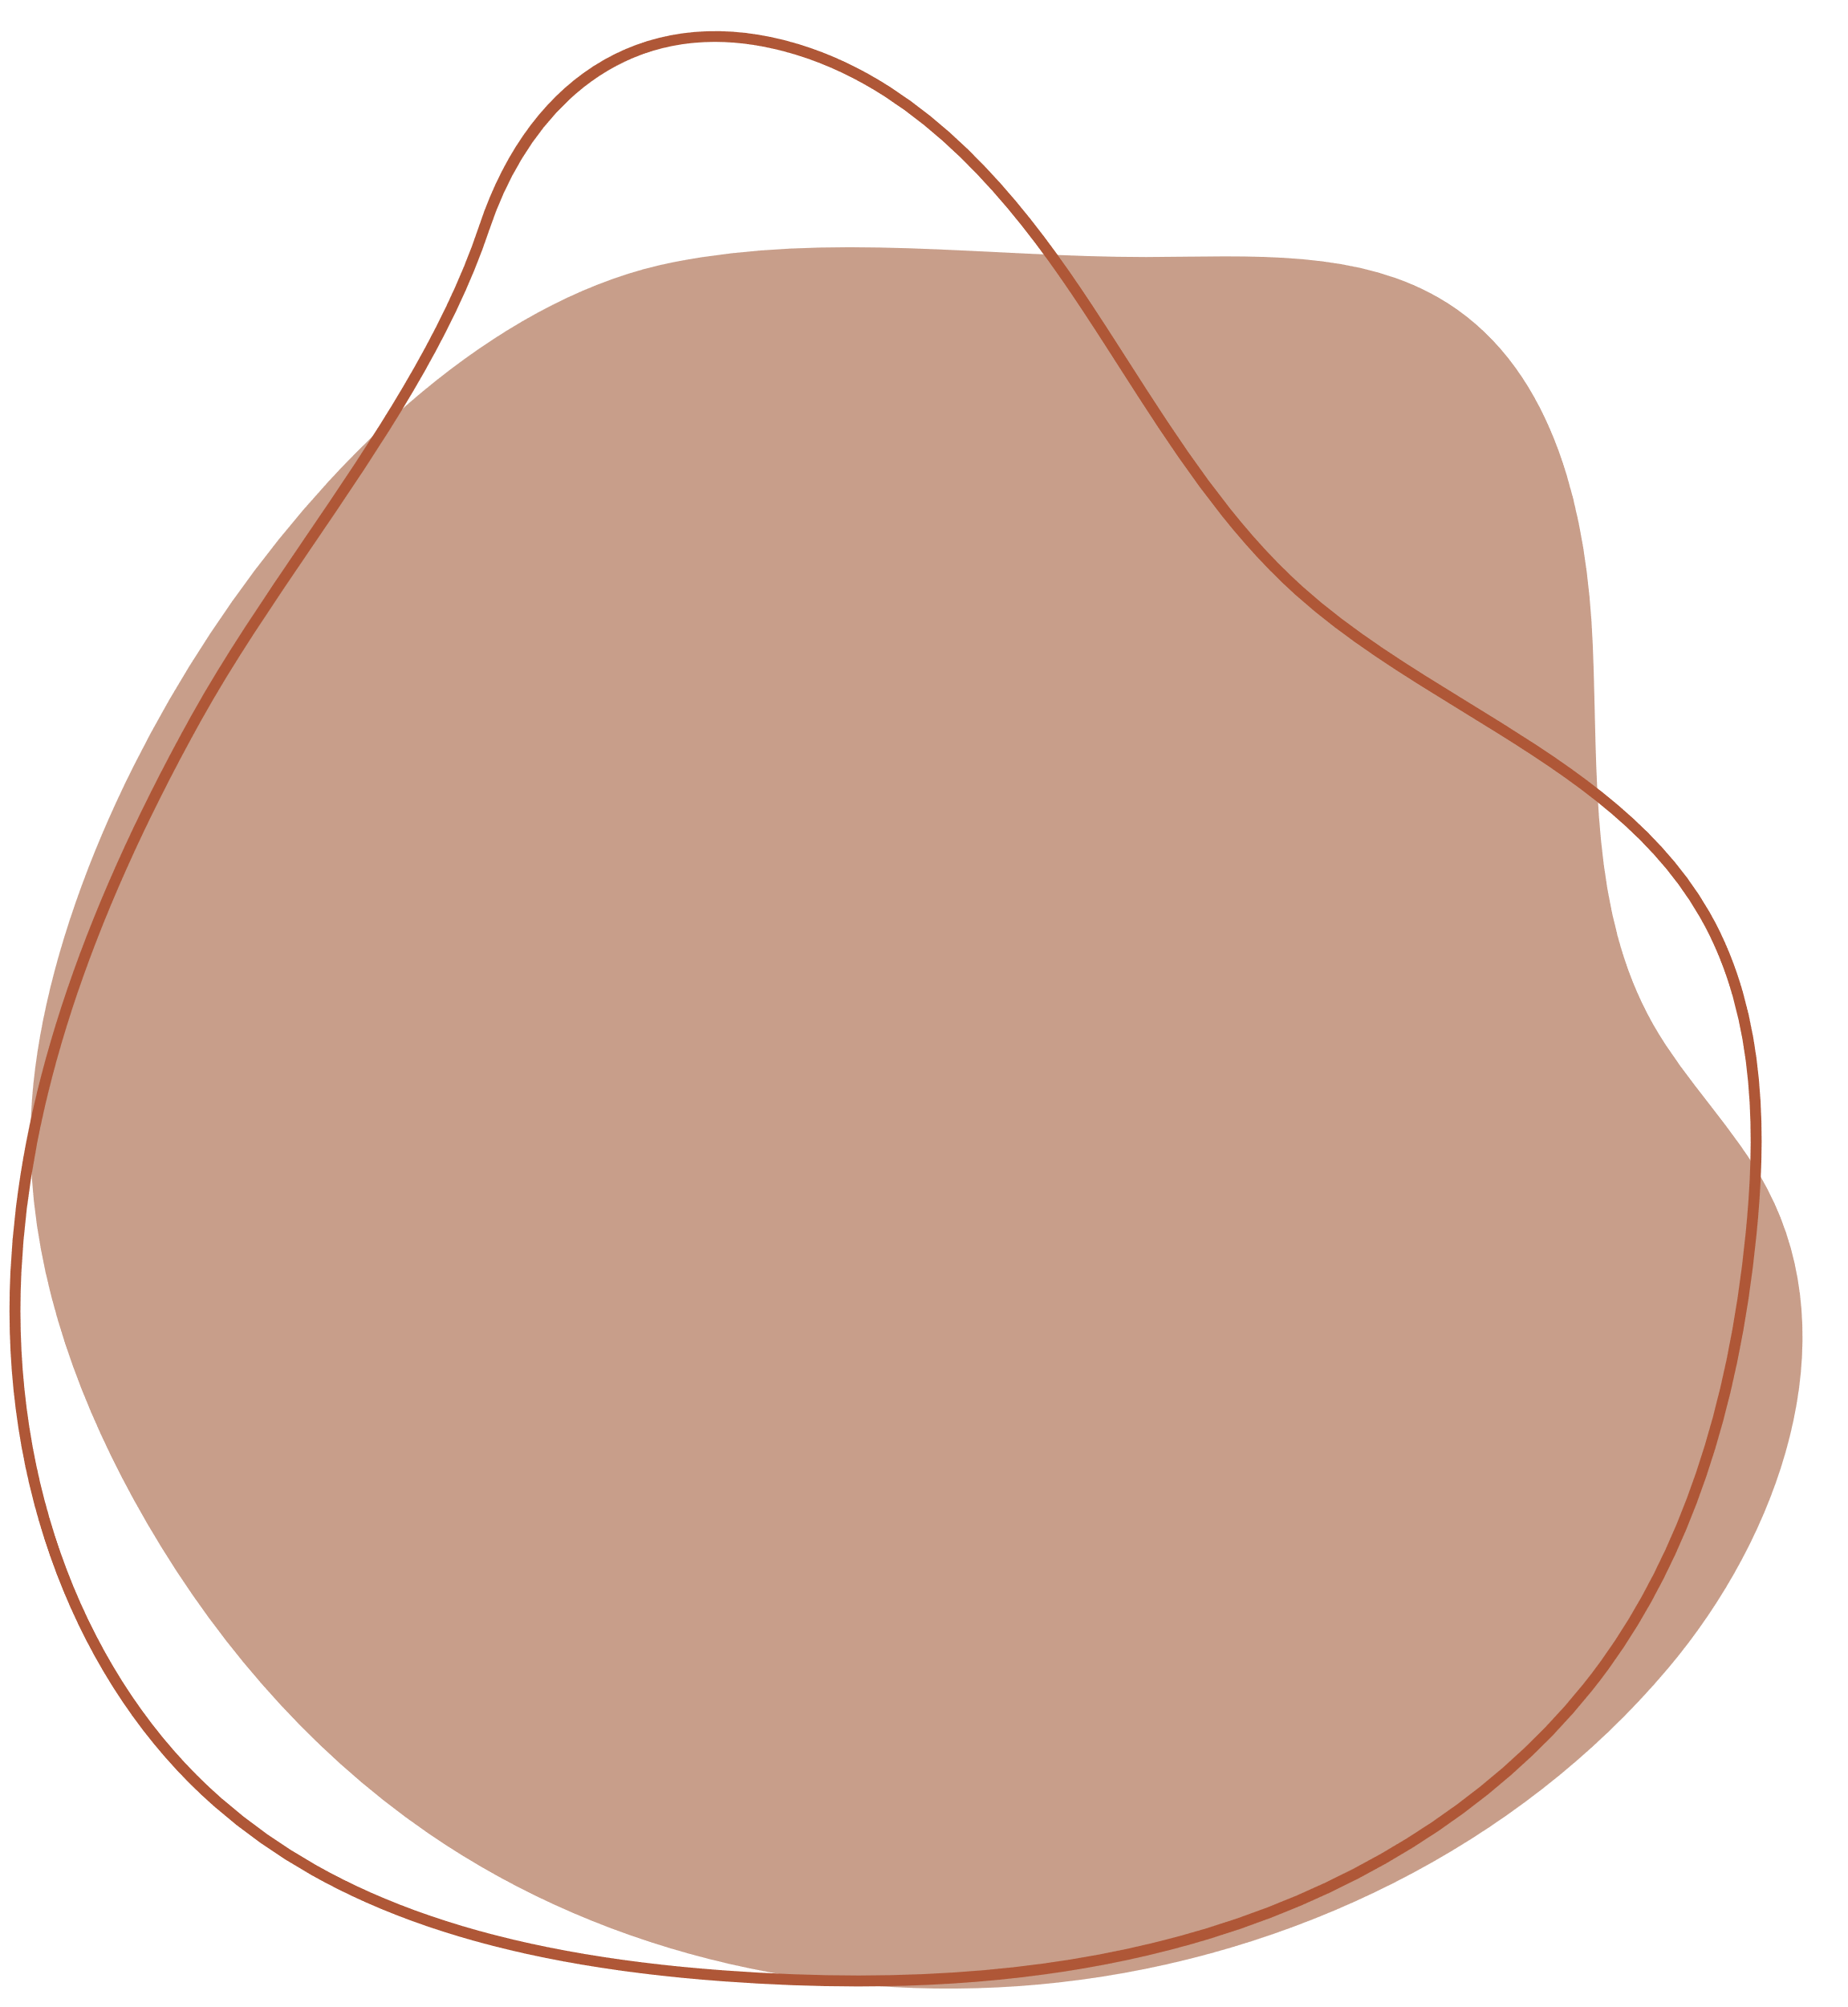

TOUR GUIDE

Slide 2
GUIDED BY: MADHUKAR RAO SASIDHAR
PRESENTERS:
2010030362_M.RUSHITHA SRI
2010030436_K.DIMPLE
2010030438_K.SIRISHA

Slide 3

TABLE OF CONTENT:
• INTRODUCTION
• ABSTRACT
• LITERATURE SURVEY
• MODULES
• TOOLS AND LANGUAGES
• GITHUB SETUP

Slide 4
INTRODUCTION
Smart Cities demand new strategies and forms of control. The traditional model of public regulation is challenged by a renewed relationship between technology, government, and society. We see smart economy, smart mobility, smart environment, smart people, smart living, smart governance, etc.
The main aim of this project is to promote city, that provides core infrastructure and give a decent quality of life to its citizens, a clean and sustainable environment and application of 'Smart' Solutions.

Slide 5
ABSTRACT
Smart Cities are a concept that has gained a lot of attention over the last decade – from solutions that ensure more efficient use and monitoring of air quality, lighting, and traffic to concepts that are designed to ensure citizen engagement and “fun” technology – and has been seen as an opportunity to redefine how we live, work, and play in our urban environments.

Slide 6
LITERATURE SURVEY
S.No: | Authors | Title | Publishing | Pros | Cons
1. | Xiaoxi Liu Xiaoling Yuan Rui Zhang Nan Ye | Risk Assessment and Regulation Algorithm for Financial Technology Platforms in Smart City | School of Economics and Finance, Xi’an Jiaotong University, Xi’an City 710049, Shaanxi, China 2Xi’an Institute of Space Radio Technology, Xi’an City 710100, Shaanxi, China. Computational Intelligence and Neuroscience 2022 (2022). | This study analyzes the investor’s emotional decision-making ability based on the information asymmetry theory and the bounded rationality theory of economic behavior. | The research on the paradigm of information regulation in the context of “financial technology” is still insufficient, and the research on the characteristics of the integration of information regulation and technology needs to be in-depth.

Slide 7
S.No: | Authors | Title | Publishing | Pros | Cons
2. | HADI HABIBZADEH, CEM KAPTAN, TOLGA SOYATA, BURAK KANTARCI, d AZZEDINE BOUKERCHE. | Smart City System Design: A Comprehensive Study of the Application and Data Planes | Habibzadeh, Hadi, Cem Kaptan, Tolga Soyata, Burak Kantarci, and Azzedine Boukerche. "Smart city system design: A comprehensive study of the application and data planes." ACM Computing Surveys (CSUR) 52, no. 2 (2019): 1-38. | Communication protocols utilize techniques such as frequency hopping to curtail these adverse effects to some extent. | communication modules cannot support a direct and reliable connection to the cloud.
3. | Ruben Sa´nchez-Corcuera, Adria´n Nun˜ez-Marcos, Jesus Sesma-Solance, Aritz Bilbao-Jayo, Rube´n Mulero, Unai Zulaika, Gorka Azkune and Aitor Almeida. | Smart cities survey: Technologies, application domains and challenges for the cities of the future. | Sánchez-Corcuera, Ruben, Adrián Nuñez-Marcos, Jesus Sesma-Solance, Aritz Bilbao-Jayo, Rubén Mulero, Unai Zulaika, Gorka Azkune, and Aitor Almeida. "Smart cities survey: Technologies, application domains and challenges for the cities of the future." International Journal of Distributed Sensor Networks 15, no. 6 (2019): 1550147719853984. | The creation of a committee to set up the best practices to implement the basic technical structure in each city and provide the basic tools to gather data from different IoT devices and exploit it. | SCs are continuously adding new services and applications for citizens to use. However, some citizens may not have the training to use these ICT-enabled services and applications.

Slide 8
S.No: | Authors | Title | Publishing | Pros | Cons
4. | Christopher Pettit, Ashley Bakelmun, Scott N. Lieske, Stephen Glackin, Karlson Charlie Hargroves, Giles Thomson, Heather Shearer, Hussein Dia, Peter Newman. | Planning support systems for smart cities. | Pettit, Christopher, Ashley Bakelmun, Scott N. Lieske, Stephen Glackin, Giles Thomson, Heather Shearer, Hussein Dia, and Peter Newman. "Planning support systems for smart cities." City, culture and society 12 (2018): 13-24. | The use of digital PSS has the capacity to enable sustainable or even regenerative growth in rapidly urbanizing areas. | Although planning practice is becoming more receptive to PSS, the development of more agile PSS tools that can invite easy, inexpensive and collaborative scenario building has not yet happened.
5. | David Eckhoff, Isabel Wagner, | Privacy in the Smart City – Applications, Technologies, Challenges and Solutions | Eckhoff, David, and Isabel Wagner. "Privacy in the smart city—applications, technologies, challenges, and solutions." IEEE Communications Surveys & Tutorials 20, no. 1 (2017): 489-516. | To break down the complexity of the smart city, we introduced taxonomies for application areas, enabling technologies, potential attackers, data sources for attacks, and different types of citizens’ privacy. | The awareness for the privacy risks that go along with the introduction of many smart city applications and technologies needs to be increased.

Slide 9
MODULES:
1.LOGIN MODULE
2.SIGN UP MODULE
3.JDBC MODULE
4.MAP LOCATIONS
5.DYNAMIC DISPOSAL OF GARBAGE

Slide 10
TOOLS:
ECLIPSE ENTERPRISE
MYSQL WORKBENCH
APACHE TOMCAT SERVER V.10
LANGUAGES:
HTML /JSP
MYSQL
JAVA

Slide 11
GITHUB:
https://github.com/KLH-JFSD/Smart-city-regulation-website

Slide 12
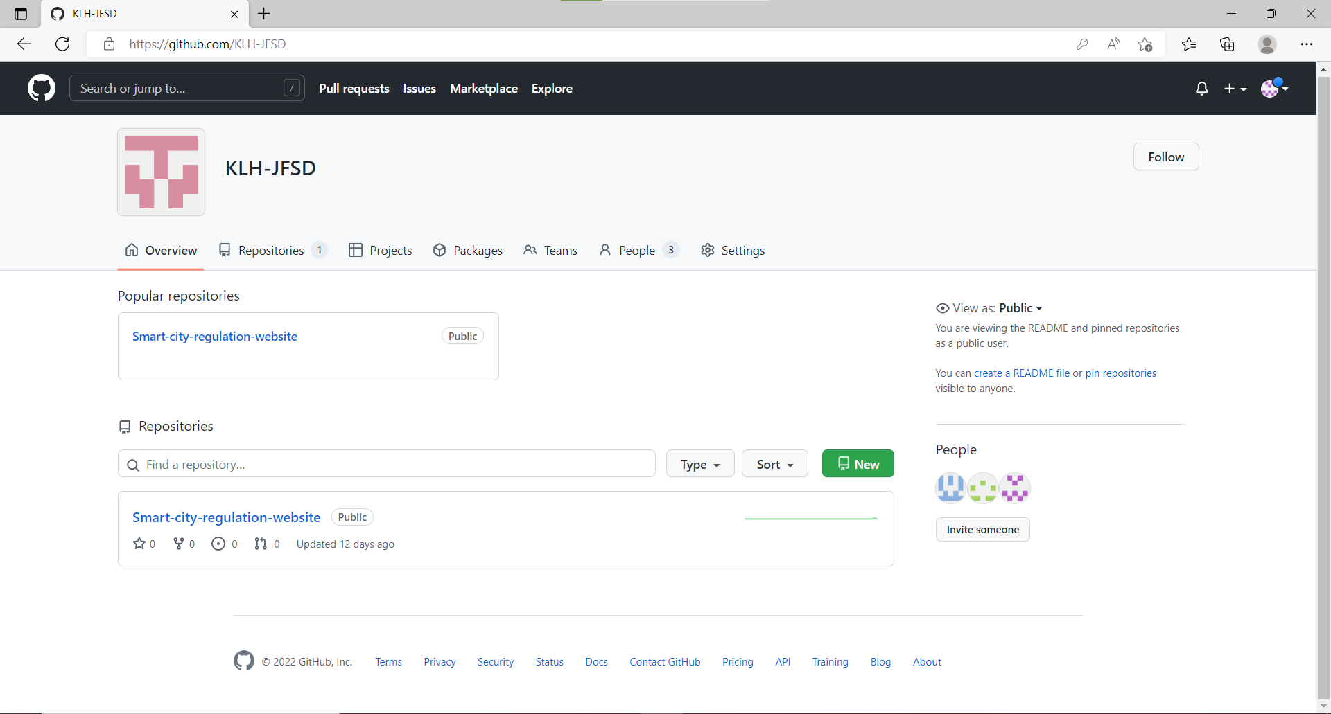
GITHUB:

Slide 13
WORK ALLOCATION:
2010030362_M.RUSHITHA : FRONT-END(FRONT END MODULES)
2010030436_K.DIMPLE : BACK-END(DATABASE CONNECTIVITY)
2010030438_K.SIRISHA : FRONT-END(FRONT END MODULES)

Slide 14
THANK YOU

